Slide 1
Family College and Financial Planning
McKeel Academy of Technology 9/24/2019

Slide 2
Questions that we will answer in this presentation
College cost of attendance- what is included.
What is the difference between grants, scholarships, loans, and work-study?
How does a student receive financial aid?

Slide 3
3 things to do soon
Do a Scholarship Search with a company that does not charge you
Fastweb https://www.fastweb.com/
Cappex https://www.cappex.com/scholarships
College Board https://bigfuture.collegeboard.org/scholarship-search
Complete the State of Florida Financial Aid Application
https://www.floridastudentfinancialaidsg.org/SAPHome/SAPHome
Complete the Free Application for Federal Student Aid (FAFSA) by the end of 2019
https://studentaid.ed.gov/sa/fafsa

Slide 4
NET PRICE
NET PRICE is the amount that a student pays to attend an institution in a single academic year AFTER subtracting scholarships and grants the student receives.
Focus on the NET PRICE.
Not the STICKER Price.

Slide 5
How Much Will it Cost?
DIRECT Costs
Tuition and Fees
On-Campus Room and Board
These costs will show up on the college bill.
Indirect Costs
Books and Supplies
Off-Campus Room & Board
Personal Expenses
Travel Costs
These costs do not show up on the college bill.

Slide 6
Tuition Costs: Private, Traditional 4-year Public, 2 to 4 year Public-”Sticker Price”
Examples of published Tuition Costs for 2018-2019
Stetson University Enrollment 4,252 Tuition & fees $46,030
Florida Southern Enrollment 3,055 Tuition & fees $36,348
Univ. South Florida Enrollment 43,540 Tuition & fees $6,410
Univ. Central Florida Enrollment 66,059 Tuition & fees $6,368
Polk State College Enrollment 10,659 Tuition & fees $3,366
Valencia College Enrollment 44,834 Tuition & fees $2,474
Source: Florida Business Daily 9/18/2019 The price of education: Which 4-year Florida schools charge the highest in-
State tuition?

Slide 7
What is the Total Cost of Education
Tuition (previous slide)
Room and Board- tend to run about $10,000 to $11,000 per year
Books and Supplies-tend to run about $1,200 per year
Person Expenses-tend to run about $1,600 per year
Transportation-tends to run about $1,100 per year

Slide 8
NET PRICE CALCULATORS-Every school has one
Available on a college’s website, net price calculators can help prospective students get a better handle on what they may pay.
Students enter information about their family’s financial situation to learn what similar students paid to attend the institution in the previous year.
Provides an estimate on cost of attendance

Slide 9
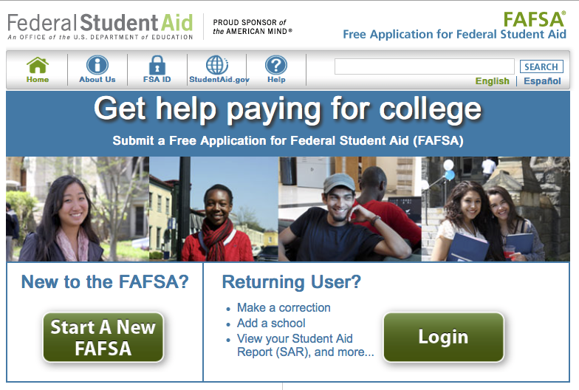
Federal Student Aid
Completing the FAFSA is the first step in securing federal aid for college, career school, or graduate school. There’s a phone app for this.
studentaid.ed.gov/sa/fafsa.ed.gov

Slide 10
FSA ID and Completing FAFSA
Get ready for the FAFSA by creating an FSA ID – a username and password combination that you’ll use to sign the FAFSA and access certain websites related to federal financial aid.
Visit https://fsaid.ed.gov/npas/index.htm to create your FSA ID, find out what information you’ll need, and learn how to fill out the FAFSA.
Think about which schools you want to receive your FAFSA information.
Complete your FAFSA (Free Application for Financial Student Aid) at www.fafsa.ed.gov beginning October 1

Slide 11
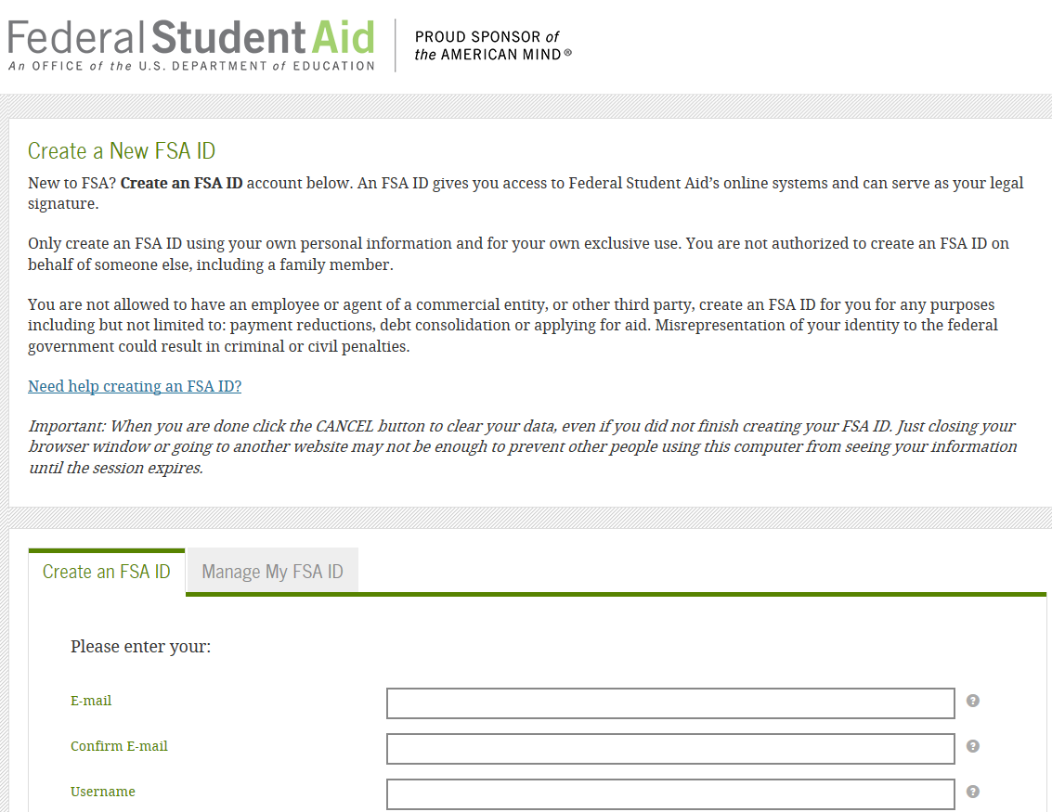
FSA ID- Both Students and Parents need one

Slide 12
an important day
October 1 is the first day that the FAFSA, can be completed and there’s a phone app for this.

Slide 13
FAFSA Data Retrieval Tool
Make sure your 2020-2021 FAFSA information is correct.
The most efficient way to do this is to use the Data Retrieval Tool (DRT) through FAFSA.
DRT links your FAFSA data to the IRS database and ensures that the FAFSA data matches IRS records.
Prior-Prior Year. 2020-2021 uses 2018 IRS Tax Return information.

Slide 14
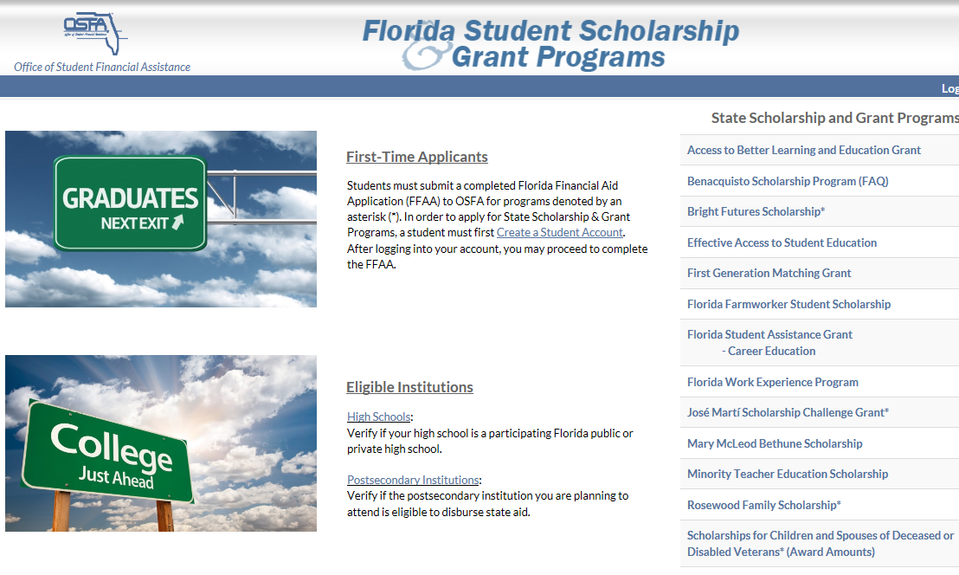
Florida Student Financial aid
Completing the State of Florida Financial Aid Application allows students to qualify for Bright Futures and other state-funded awards.
Do not fail to apply! Community service is required for Bright Futures.
http://www.floridastudentfinancialaid.org/ssfad/home/uamain.htm

Slide 15
Bright Futures Eligibility

Slide 16
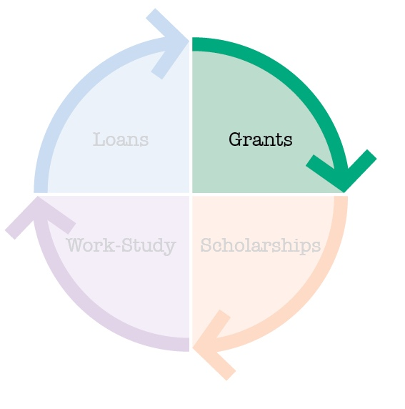
Grants-Do not have to be repaid
Federal Pell Grants $657 to $6,195
Federal Supplemental Education Opportunity Grants (FSEOG) Variable based upon the school
State Grants Variable based upon the school
Campus Based and Not Campus Based what is the difference?
Institutional Grants

Slide 17
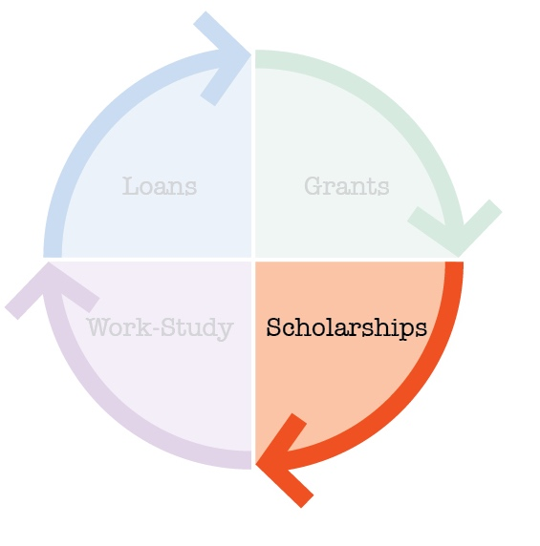
Scholarships
Institutional
Athletic, Academic, Leadership, Theatre, Music
Usually Competitive
State, Local, or Civic
-Do a Scholarship Search and work it

Slide 18
Be Smart About Scholarships-the key to lower borrowing rates
Thousands of scholarships exist. Some colleges automatically consider all applicants for scholarships. Private sources require special applications and additional work and motivation to make it happen.
Be careful paying money to apply to an outside scholarship.

Slide 19
Helping with Outside Scholarships

Slide 20
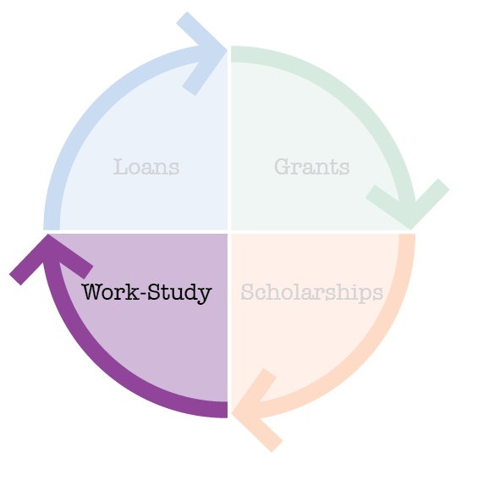
Work-study (Self Help Aid)
Based on demonstrated need for federal work study
Institutional work not need based
Student applies for on-campus job
10 – 15 hours maximum per week-paid directly to student
Generally at/above minimum wage

Slide 21
Watch your work hours
When it comes to financial aid, a college job can backfire
Watch the $7,000 Limit
Federal work study does not count in FAFSA Income for the next FAFSA year
Work off campus does count in the FAFSA Income for the next FAFSA year

Slide 22
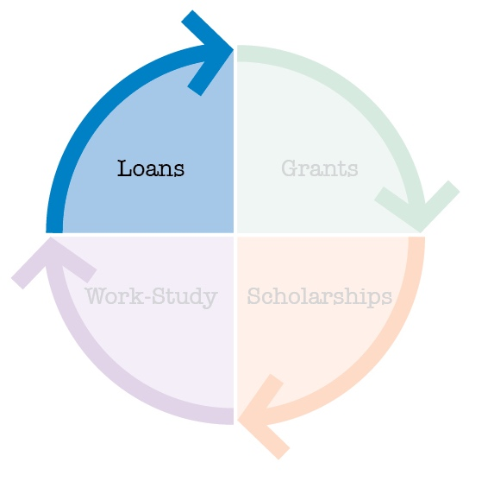
Savings or Loans (Self Help)
Direct Subsidized & Unsubsidized
Subsidized the federal government pays the interest while in school
PLUS (Parent Loan for Undergraduate Students)
Private Loans

Slide 24
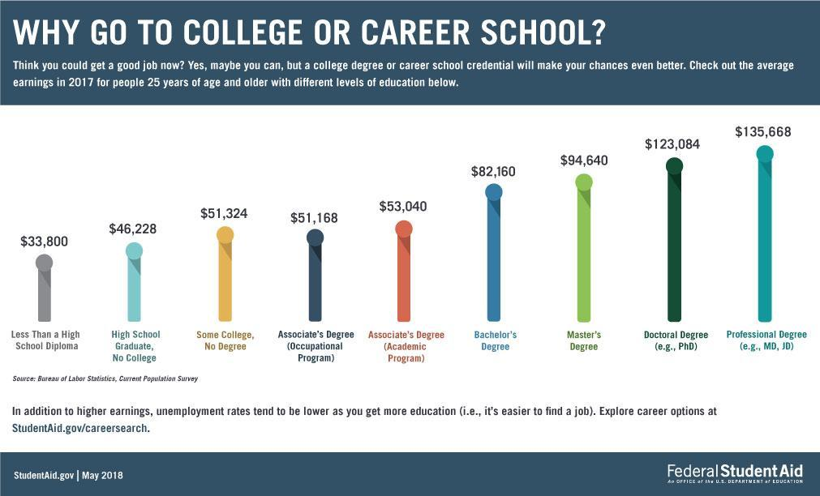

Slide 25
3 things to do very soon
Do a Scholarship Search with a company that does not charge you
Fastweb https://www.fastweb.com/
Cappex https://www.cappex.com/scholarships
College Board https://bigfuture.collegeboard.org/scholarship-search
Complete the State of Florida Financial Aid Application
https://www.floridastudentfinancialaidsg.org/SAPHome/SAPHome
Complete the Free Application for Federal Student Aid (FAFSA) by the end of 2019
https://studentaid.ed.gov/sa/fafsa

Slide 26
Thank you!
Questions?

